Slide 1


SMART INDIA HACKATHON 2024
Student Innovation
Problem Statement ID – SIH1598
Problem Statement Title –
“Ideas that showcase the rich
cultural heritage and traditions of
India”
Theme - Heritage and Culture
PS Category - Software
Team Name – Vasudhaiva Kutumbakam
1

Slide 2
TEAM MEMBER DETAILS
Vasudhaiva Kutumbakam
NAME | REGISTRATION NO. | CONTACT DETAILS
1. PRABHAS CHAUBEY | 20235056 | 7250319673
2. CHAITANYA GAJBHIYE | 20236048 | 8766927503
3. PRIYANSHU KUMAR | 202235136 | 7050574425
4. BHUMIKA CHAHAR | 20236045 | 9257944607
5. SUPRIYA SINGH | 20237055 | 8957851323
6. VANESSA SHRIE | 20235094 | 8340519532
2

Slide 3
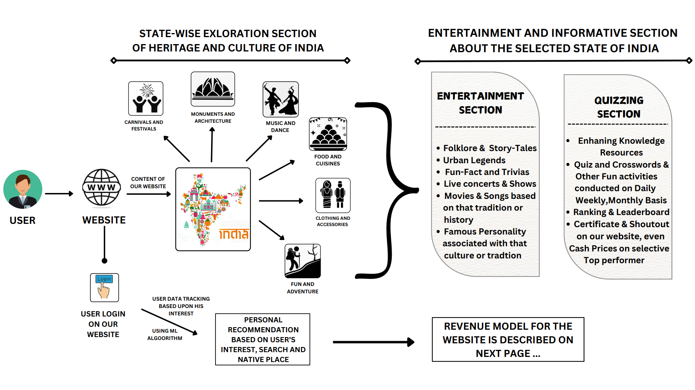
CUL-TECH APPROACH
Vasudhaiva Kutumbakam
IDEA / SOLUTION DETAILS –
IDEA : Our Team is proposing a full stack website which will promote the “RICH CULTURE HERITAGE AND TRADITION OF INDIA”
in a unique manner.
SOLUTION –
3

Slide 4
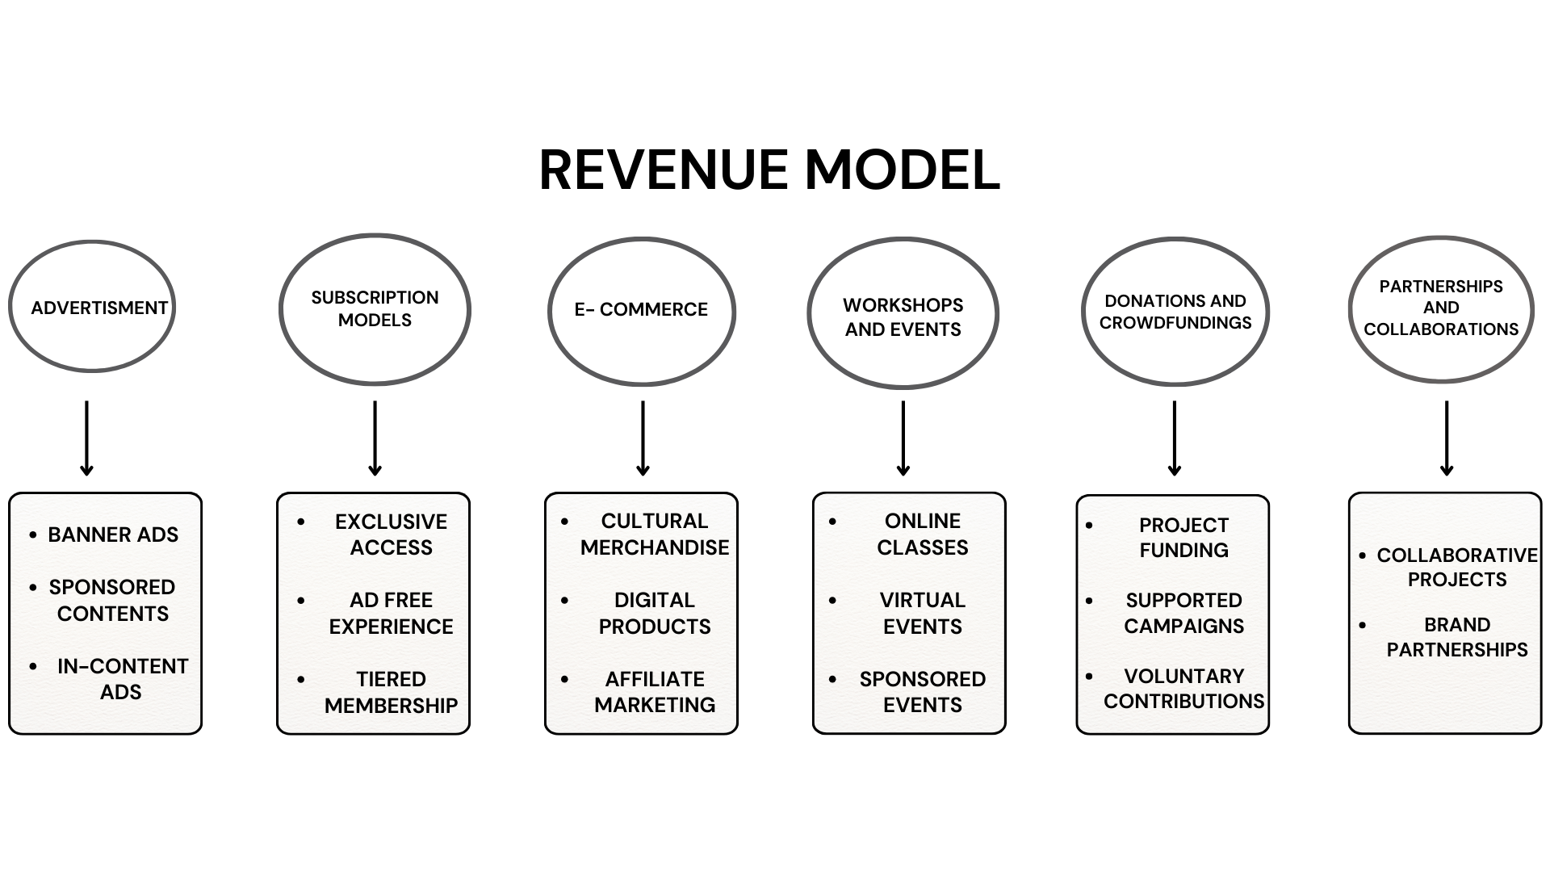
Vasudhaiva Kutumbakam
WEBSITE’S REVENUE MODEL
4

Slide 5
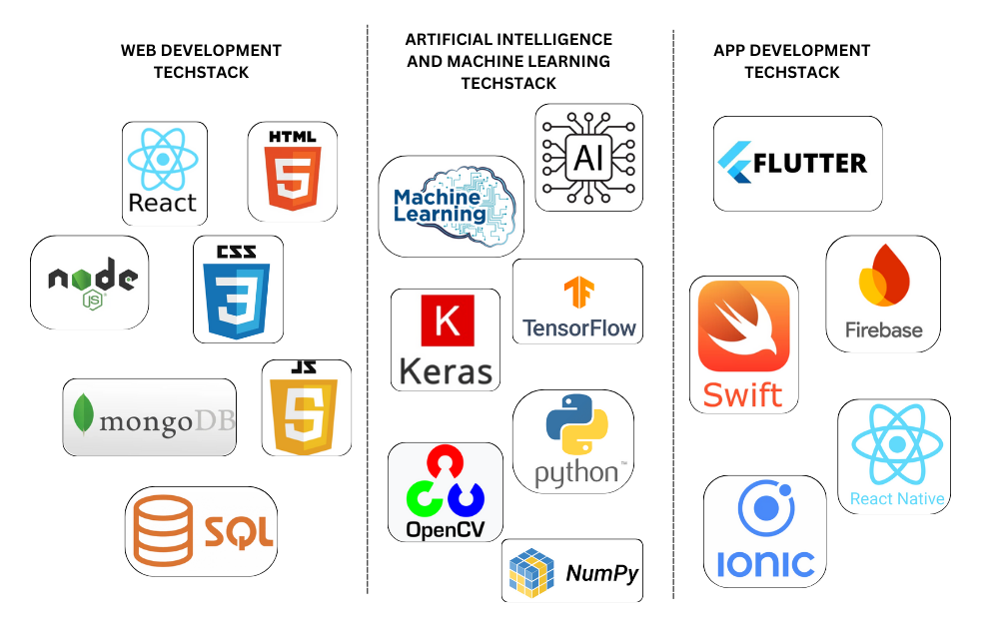
TECH-STACK REQUIRED
Vasudhaiva Kutumbakam
5

Slide 6
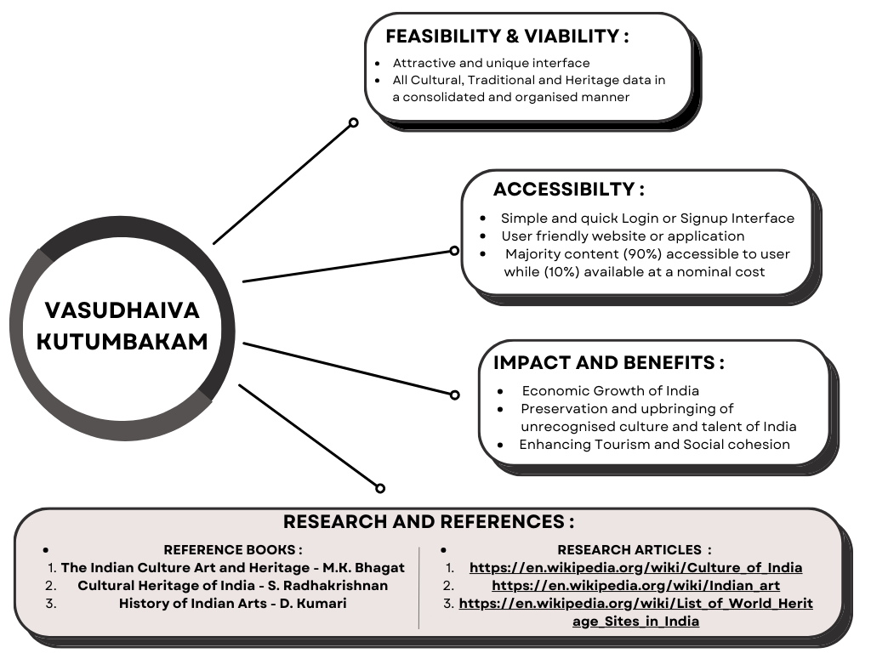
Vasudhaiva Kutumbakam
6

